Slide 1

STAT3612 Statistical Machine Learning
Group Project
Machine Learning Models for the Electronic Health Records (EHRs)
CHAN Yuk Wai Xtra
DING Zhui
WANG Xizhuo
YU Xinyao
YUNG Yiu Yin
🌟Superpass!

Slide 2
Agenda
01
Data pre-processing​
Data Exploration
Feature selection
Training process
Model Selection & Performance Comparison
Parameter Tuning & Imbalance solution
Interpretation
Some more insight about multi-tasking
Conclusion
02
03
04
05

Slide 3
PART 01
Data pre-processing​

Slide 4
Data exploration
Original dataset: 7488 features (every 1 hour in 1 day)
How to merge the value in 24 hours into a single value?
Search for medical meanings→select aggregation function
Eg. Mean/max/min
Later, we discover that picking min/mean/max vs simply picking mean have the similar result
Notes:
The original dataset contains more than 7 thousand features and we considered combining some columns because they are detecting the same medical factors every hour.
Hence, we searched for the medical meanings behind them to choose a representative aggregation value like mean, max, or min.
Also, we plotted analytical graphs like histogram box, and scatters to have a straightforward understanding of how each feature affects the outcome.

Slide 5
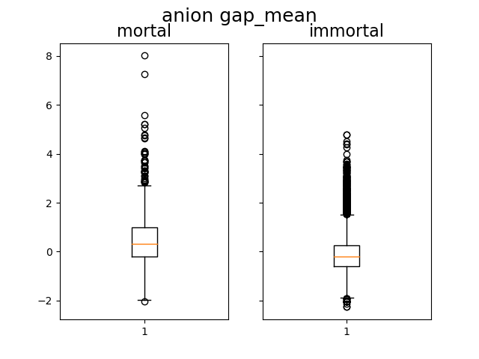
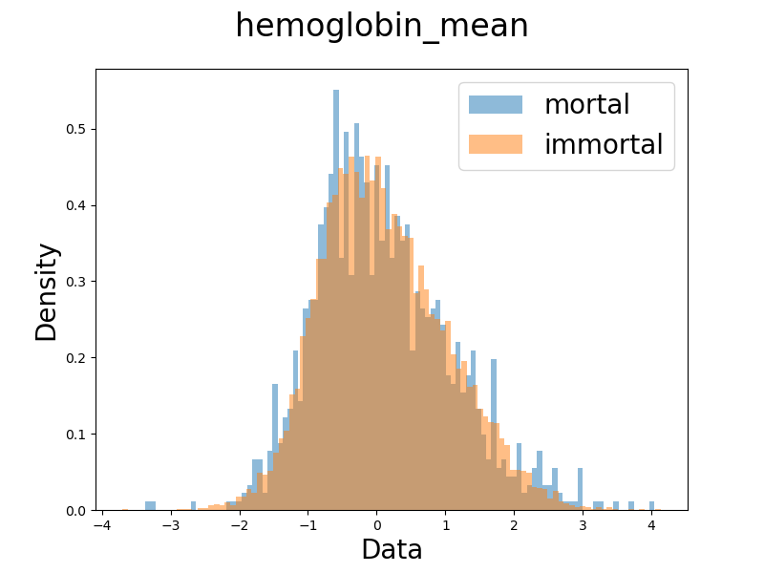
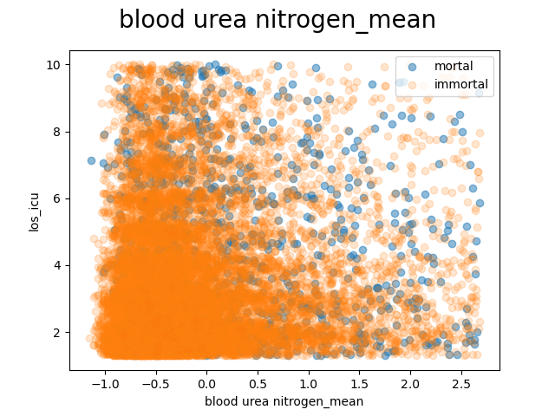
Data exploration—plot examples
Histogram/box plots/scatter plots
Group by mortal/immortal
Feature mean vs length of stay in ICU
Notes:
These are three examples of our plots. In our box and histogram plots, we grouped the observations by mortal and immortal status for comparison.
In the scatter plot, we have the length of stay on y-axis to see the variable correlation with the predicted value.
These plots also give us useful information for feature selection because a higher variance in distribution between groups indicates importance of the feature in explaining the outcome.
Whereas the scatter cannot give us much information for too many points and outliers.

Slide 6
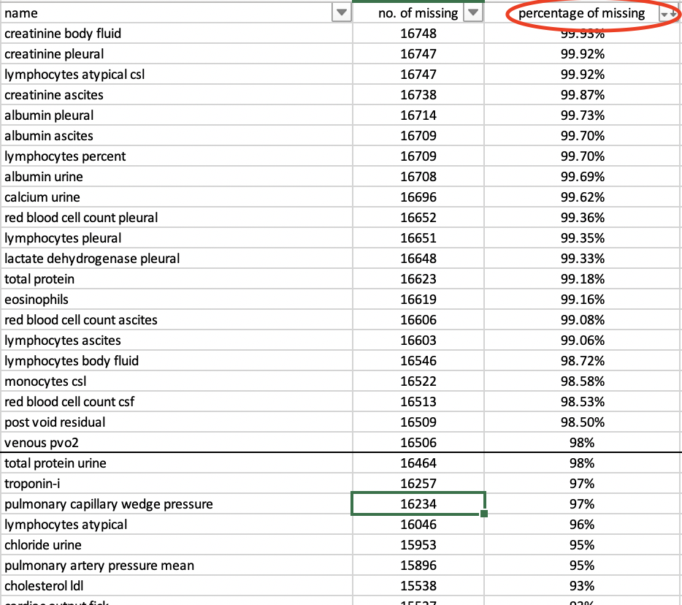
Feature selection
Eliminate those containing a lot of missing values
After several trials, kicking out top 20 missing predictors is optimal
For predictors with lower smaller amount of missing value, we impute the missing value by the mean
Compute the pairwise correlation among predictors
if two variables are highly correlated, eliminate one of them

Slide 7
Feature selection
For the mean of each predictor over the 24 hours, apart from simply taking the mean of 24 hours, we also consider range and standard deviation
Reason: fluctuation within a short period of time may lead to death
We also consider mask and time since measure
Mask: sum
Time since measure: mean
Including mask can improve performance but time since measure cannot, neither adding both

Slide 8
PART 02
Training process​

Slide 9
Task 1: Model Selection & Performance Comparison
We first tried 7 different models
Logistic Regression:
Easy to interpret
4 Decision tree models: (AdaBoost, Gradient Boost, XG Boost, Random Forest)
Robust to outliers and correlated features
Incorporate non-linearity
A balance between interpretability and complexity
Proposed by the MIMIC extract paper (random forest had high AUC)
XGBoost → robust toward missing data
KNN:
Non-linear and intuitive
SVM:
Memory efficient

Slide 10
Task 1: Model Selection & Performance Comparison
Step 1: Fit the 7 models with default parameters on training dataset and compare validation AUC
Logistic Regression: Low AUC and not many parameters to tune -> Drop
KNN: Low AUC → but want to proceed to tune parameters
Others: satisfactory AUC → proceed to tuning parameters
Model | Validation AUC
Logistic Regression | 0.7904
Random Forest | 0.8189
AdaBoost | 0.8263
Gradient Boost | 0.8344
KNN | 0.6434
SVM | 0.8344
XG Boost | 0.8344

Slide 11
Task 1: Model Selection & Performance Comparison
Step 2: 1st round of unsystematic tuning parameters and compare the AUC
KNN (AUC: 0.78) & SVM (AUC: 0.855) --> relatively low AUC -> the model potential is low so dropped
Step 3: 2nd round of systematic tuning parameters (grid search) on 6 datasets and compare the cross-validation AUC
Task 1: Classification​​​​ | Adaboost​​​​ | Gradient boost​​​​ | Random forest​​​​ | XG Boost
All features (mean+std+range) | 0.8737 | 0.8889 | ​​​​0.8689(val) 0.8782(test) | 0.8875
Less features (mean+std+range) | ​​​​0.8727 | 0.8937 | ​​​​0.8744(val) 0.8841(test) | 0.8898
All features (mean+range) | ​​​​0.883(val) 0.8871(test) | 0.8953 (val) 0.9114 (test) | ​​​​0.8717(val) -(test) | /
Less features (mean+range) | ​​​​0.8816(val) 0.8870(test) | 0.8925 (val) 0.914 (test) | ​​​​0.8746(val) -(test) | 0.8973
All features (mean+std) | ​​​​0.873 | 0.8947 | ​​​​0.8789(val) 0.8934(test) | /
Less features (mean+std) | 0.8708 | 0.8933 | 0.8823(val) 0.9013(test) | /

Slide 12
Task 2: Model Selection
The approach of selecting model are similar to task 1, we first tried different models: Linear Regression (LASSO, Ridge, Efficient Net), Gradient Boost, KNN, Support Vector Machines and XG boost
Interestingly, we found that models that work bad in task 1 also work bad in task 2, and vice versa
We directly apply the best parameter and model in task 1 to task 2 (gradient boost), the result is surprisingly encouraging → insight about multitasking
Best Scenario | Gradient Boost | SVM | KNN | AdaBoost | Random Forest
Classification AUC | 0.914 | 0.845 | 0.777 | 0.887 | 0.901
Regression MSE | 1.73 | 1.83 | 1.86 | 1.79 | 1.75

Slide 13
Parameter Tuning: Step1
Grid Search (with wide step) Cross Validation to determine baseline model
Model Name | Grid Searched Best Params | AUC(CV fold=5)
Gradient Boosting | learning_rate = 0.1 min_samples_split = 500 min_samples_leaf = 50 max_depth = 8 max_features = ‘sqrt’ Subsample = 0.8 | 0.8885
Adaboost | N_estimators = 20 learning_rate = 0.25 max_depth = 1 | 0.8823
Random Forest | max_depth = 30 n_estimators = 500 | 0.8774

Slide 14
Step 2: fine tune
Take gradient boost as example
Set a relatively high learning rate
Optimise:
N_estimator (AUC → 0.8887)
Max_depth (AUC → 0.8913)
min_samples_split & min_samples_leaf (AUC → 0.8959)
Expand N_estimator & decrease learning (AUC → 0.8989)

Slide 15
Imbalance
Modify class weight
class_weight={0.0: 0.1, 1.0: 1.0} → improvement: +1.5% in AUC
Undersample/oversample
Undersample + parallel training → improvement: +2% in AUC
Model 1
1/5 immortal
all mortal
Model 2
1/5 immortal
all mortal
Model 3
1/5 immortal
all mortal
Average prediction
Model 4
1/5 immortal
all mortal
Model 5
1/5 immortal
all mortal
Notes:
During the training process, we considered how to handle the imbalance in the given dataset. Here are some mechanisms.
Since the tree models do not always perform well on the imbalanced dataset, we adjusted the class weight during fitting to give more penalty to wrongly predicted minority classes. The optimized class weight is about the reciprocal of the class ratio. This increased by about 1.5% in cross-validation AUC.
Furthermore, we designed our algorithm for resampling in the classification problem that can be regarded as a bagging method. That is, we randomly split the majority class and combined each of them with all the majority class. After training five parallel models, we averaged the predictions as the final result. This increased by about 2% in cross-validation AUC.
(126)

Slide 16
PART 03
Interpretation

Slide 17
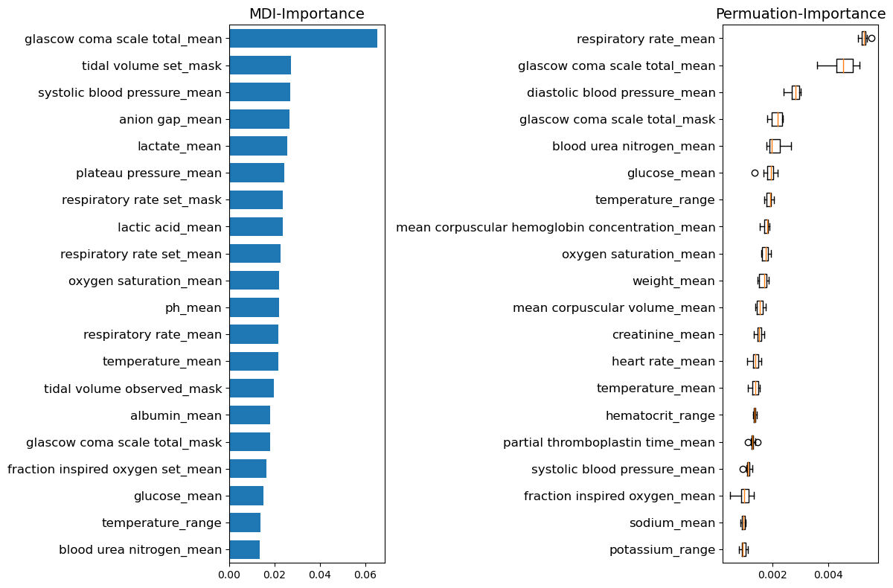
Interpretation
Importance:
Identify fatal factors for health care
Gradient boosting
importance plot
Linear regression
p-value/shrinking effect of LASSO
Notes:
Predicting mortality and length of stay in the ICU has great significance in real medical applications for conducting first aid or giving medicine. Knowing the impact of each value has substantial practical implications.
Although we have sacrificed part of the interpretability using these ensemble methods, we are still glad that it can output the importance of the features in the decision tree so that we can further check which factors matter. One the right-hand side is an example of our plot for analyzing importance based on decrease in impurity or decrease in auc.
We also combined the results with the output of the penalized linear regression model for interpretation.

Slide 18
Factors important in both 2 methods (Task 2)
p-value<0.05 & ranked top15 in importance: Most (11) factors are shared → they are important!
Statistically Significant Factors | Rank in GBRegressor
positive end-expiratory pressure set_mask | 1
glascow coma scale total_mean | 2
blood urea nitrogen_mean | 3
respiratory rate_mean | 4
fraction inspired oxygen set_mean | 6
positive end-expiratory pressure set_mean | 8
diastolic blood pressure_mean | 9
mean corpuscular volume_mean | 10
heart rate_mean | 11
partial thromboplastin time_mean | 12
fibrinogen_mean | 14
Notes:
This form gives the features that are both ranked top 15 in the importance of in our boosting tree and also had significant p-value in the linear regression. As most of the important features are shared in both models indicates that the model results justify each other.

Slide 19
Important Factors
Important in tree models but non-significant in linear:
Large p-value & ranked top15 in importance
Non-linear influence
Interaction effect/correlation
Feature names
mean corpuscular volume
partial thromboplastin time
tidal volume set
tidal volume spontaneous
Depend on physical condition (height/weight)
Notes:
However, there are some other features that have high ranks of importance in the tree model but did not show importance in the linear model. Combined with our search of the medical meaning, we found those features may have a non-linear influence on the outcome. For example, the patient may have serious problems in coagulation when the partial thromboplastin time is too high or too low. Also, for the tidal volumes, the doctor may set differently for different patients depending on their height or weight. Also, the correlation between features still exits but the linear model may fail to capture it because we did not add interaction terms.

Slide 20

Trade-off: Accuracy vs Interpretability
Classification task:
Low AUC of interpretable model
$AUC_{logis}$: 0.868 vs $AUC_{GB}$: 0.914
In this task, Gradient boosting > logistic regression
Regression task:
Accuracy:
$RMSE_{GB}$: 1.73 vs $RMSE_{linear}$: 1.76
Similar important factors (in linear regression and gradient boost)
Interpretability:
Boosting: only importance vs Linear: significance + direction +scale
Which one is better? → depends on the goal (inference or prediction)
Notes:
Finally, we want to discuss our insight about the trade-off between accuracy and interpretability. In the classification task, boosting method outperforms simple linear models a lot, so gradient boosting method is suggested for higher AUC.
In the regression task, however, it turns out that the linear model and complex model has a closer error and also give very similar important factors.
Whereas compared with the linear model, the gradient has quite weak interpretability with only importance information. Linear model, on the other hand, can give us the significant values, the changing direction and even the scale. In such cases which model is better should depends on our goal. More interpretation power gives more information on inference, which helps the hospital to focus more on the fatal indicators. However, if we aim for higher prediction accuracy, we should probably turn to complex models.

Slide 21
PART 04
Some more insight about multi-tasking

Slide 22
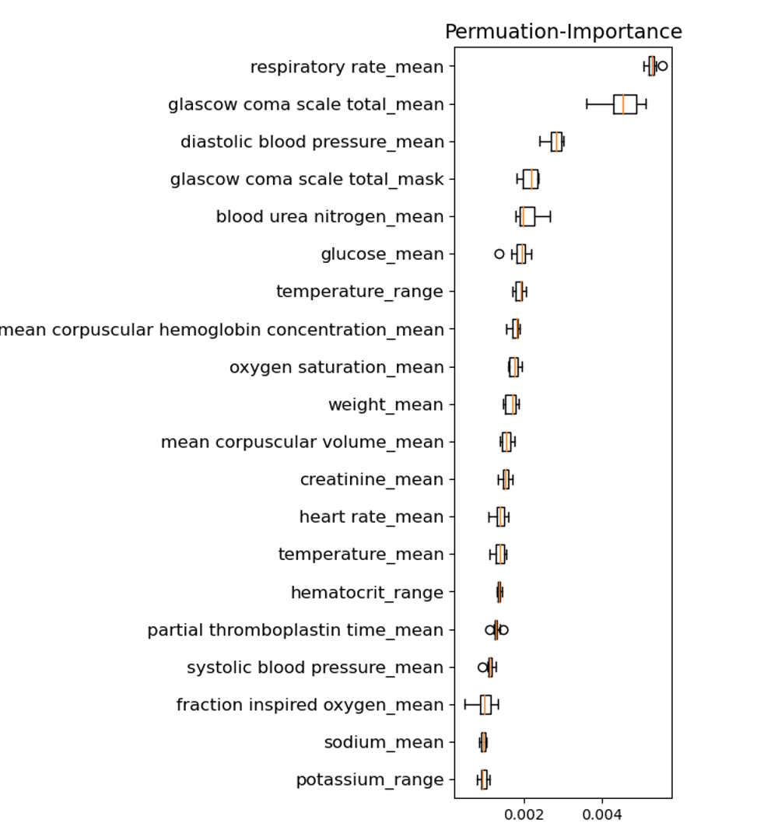
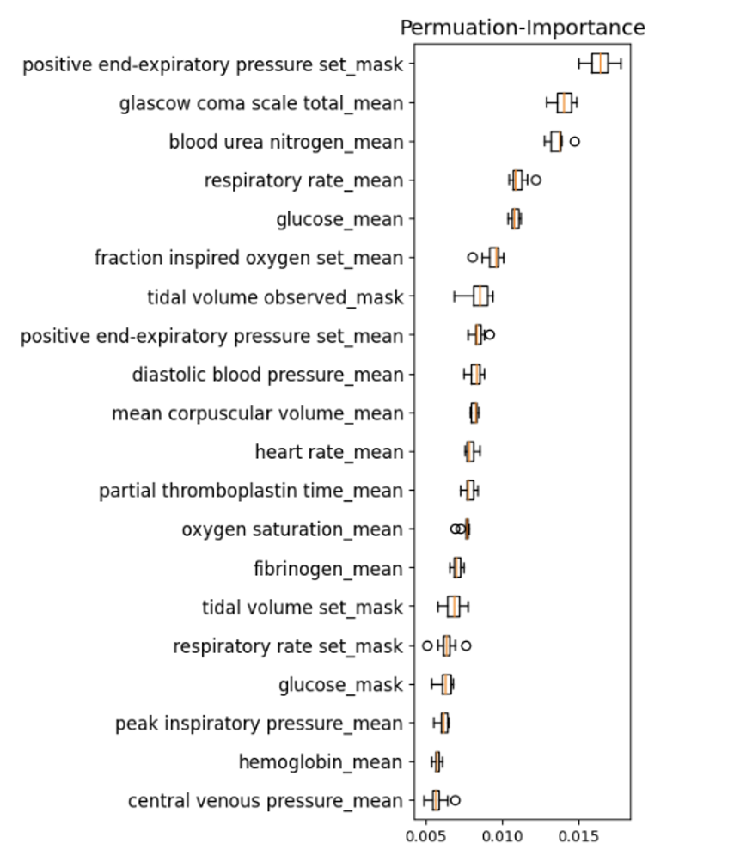
Task1 vs Task2— common important factor
classification
regression

Slide 23
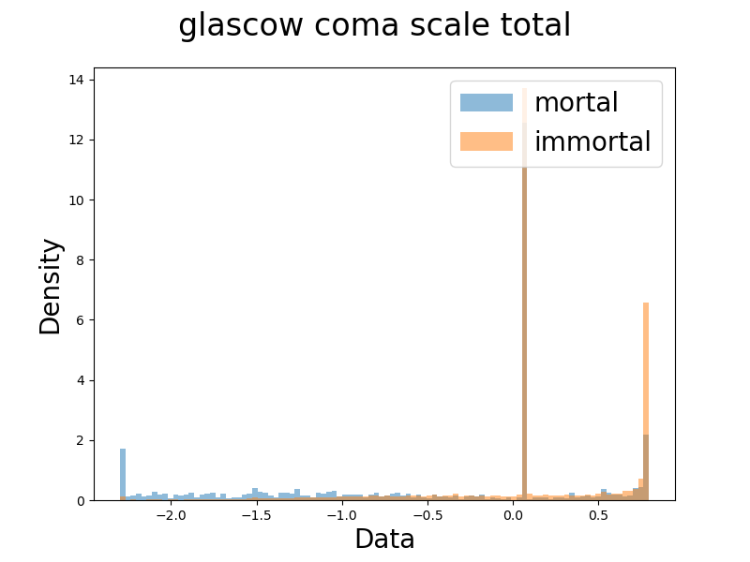
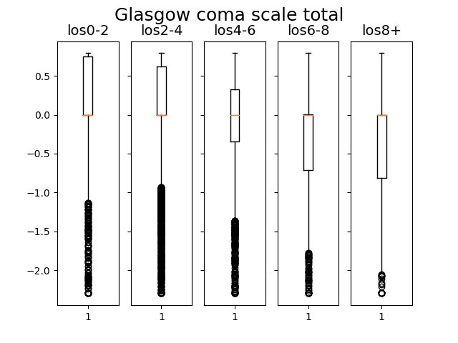
Example—glasgow coma scale
High value → patient is awake
low value → patient loss conscious

Slide 24
Task1 vs Task2—unique importance
classification
regression

Slide 25
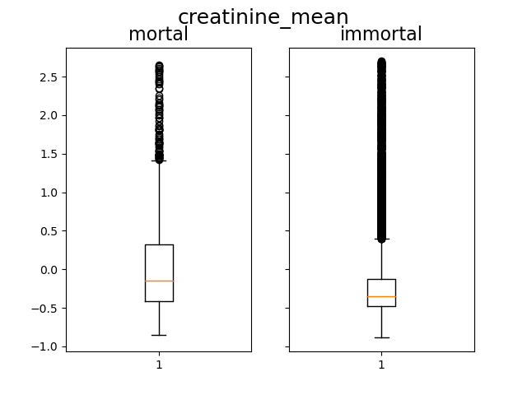
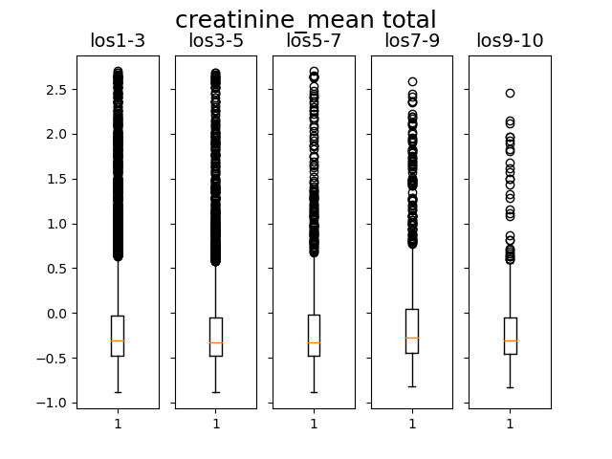
Creatinine—higher creatine→ kidney failure
person who dies has higher creatine
Important in mortality prediction but not LOS

Slide 26
Real life application
For factors that are important in task 1 but not task 2
More attention should be paid
If we observe an optimal value of these factors in the patient → can be allowed to leave the hospital earlier
Better allocation of medical resources

Slide 27
PART 05
Conclusion

Slide 28
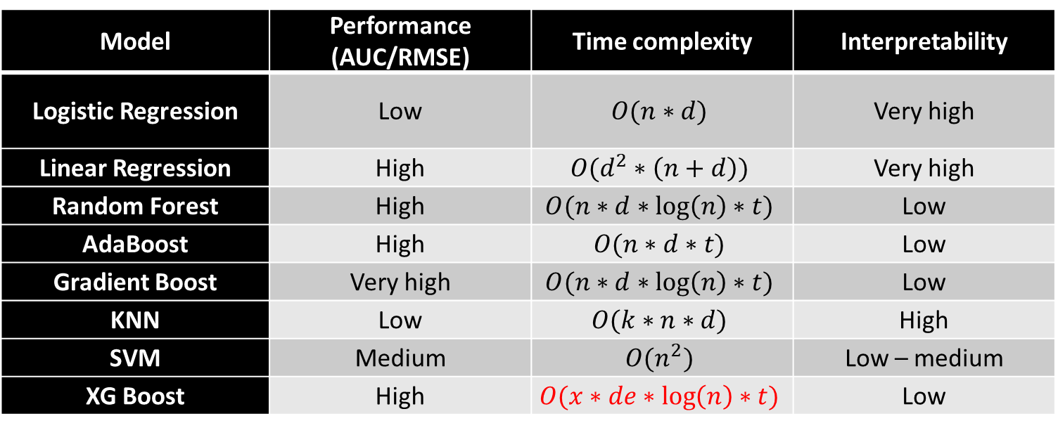
Model Comparison
Model | Performance (AUC/RMSE) | Time complexity | Interpretability
Logistic Regression | Low | $$O(n∗d)$$ | Very high
Linear Regression | High | $$O(d^{2}∗\left(n+d\right))$$ | Very high
Random Forest | High | $$O(n∗d∗\log\left(n\right)∗t)$$ | Low
AdaBoost | High | $$O(n∗d∗t)$$ | Low
Gradient Boost | Very high | $$O(n∗d∗\log\left(n\right)∗t)$$ | Low
KNN | Low | $$O(k∗n∗d)$$ | High
SVM | Medium | $$O(n^{2})$$ | Low – medium
XG Boost | High | $$O(x∗de∗\log\left(n\right)∗t)$$ | Low
XGBoost run surprising fast!
Where n = no. of data, d = no. of predictors, k = no of neighbour, t = no. of tree, x = no. of non-missing entries, de = depth of tree

Slide 29
Model building strategy (insight for future work)
Choosing correct feature
Choose correct model
Tune parameter

Slide 30
Is pursuing a higher performance on available data the most important goal?
Your model works good in current data (including test data)
How about new data?
Fitting too well in current data may mean overfit!
Interpretability maybe more important
When you know why your model make this prediction, you are more likely to make correct prediction when you have new data
“The problem is that a single metric, is an incomplete description of most real-world tasks.” (Doshi-Velez and Kim, 2017)

Slide 31
THANK YOU

Slide 32
Multi-task preprocessing
Some factors are found important in one task but not another
It’s normal and physiological fact are met
For instance, Positive End-Expiratory Pressure (PEEP) is important in length of stay but not mortality
PEEP is used when a person needs mechanical ventilation because they are unable to breathe on their own
Of course a person who need PEEP will stay in hospital long, but with the PEEP, it is unlikely that they die with the aid of the ventilation machine

